Slide 1
Transition to Year 7
July
2020
A new school year, a new challenge to overcome.

Slide 2
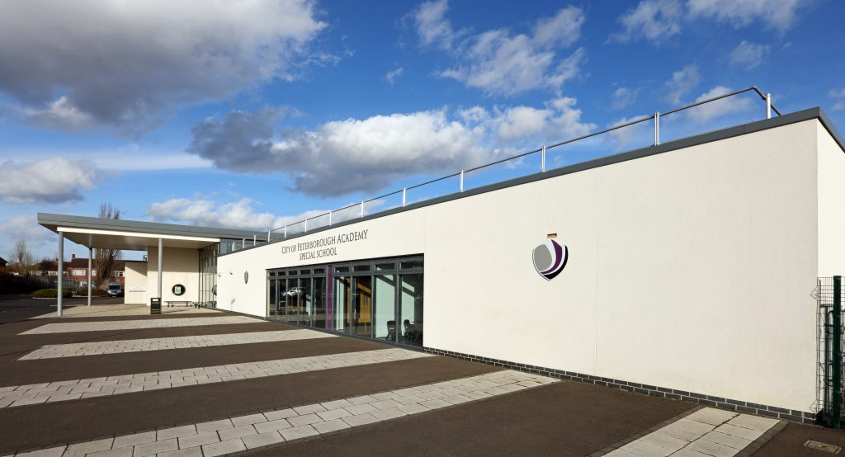
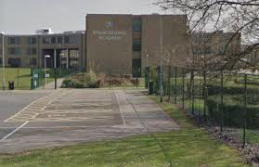
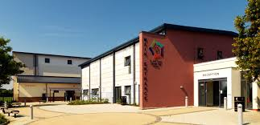
My Secondary School

Slide 3
Typical Timetable
Can you explain how lunchtime works?
What is ‘tutor time’?
Here is a blank example of a timetable to show your lesson timings.

Slide 4
Types of Lesson
Lessons
Tutor Time*
Maths
Literacy
Science
Geography
History
DT*
Performing Arts*
Art
MFL*
RE
PE
What are the subjects with a * next to them?
Here is a list of subjects that you will study at secondary school.

Slide 5
School Uniform
LIST OF ITEMS
GIRLS/BOYS BLAZER
WHITE SHIRT
HOUSE COLOUR TIE
MENZIES BLACK & WHITE CHECKED SKIRT
APTUS SPORTS SHIRT
1/4 ZIP TOP
GIRLS SKORT
SPORTS SOCKS
SPORTS SOCKS

Slide 6
School Uniform
What colour is your house tie?
Can you find 3 differences compared to our uniform?

Slide 7
Equipment

Slide 8
Equipment

Slide 9
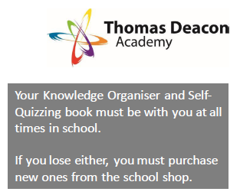
Homework: Knowledge Organiser

Slide 11
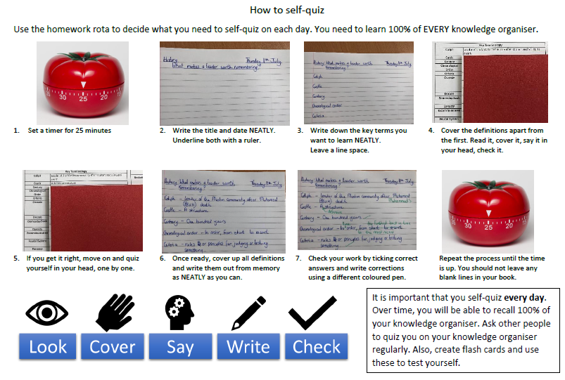

Slide 13
Houses
What are the houses for?
How do you score points?
At TDA we have six houses…
Sandown
Trinity
Highfield
Castle
Milton
Which house is missing?
Atherstone – what colour is it?

Slide 14
The School
The school is BIG but once you get used to it, you will navigate your away around easily!

Slide 15
The School
Using your map of the school, complete the navigation challenge?
Find the rooms for each lesson and label/colour them.
Number the rooms in the order you have the lessons.
Find the school refectory and break area and label/colour them.
Describe your route from each lesson/location to the next.
Use the floor number, college names and room numbers!

Slide 16
Yr6-Yr7
Do you have any questions?

