Slide 6
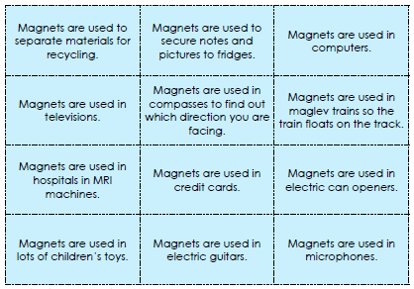
Now cut out the magnets picture and descriptions cards and match the correct description to each picture.

