Slide 1

An Introduction to GCSE Pod
Students

Slide 2



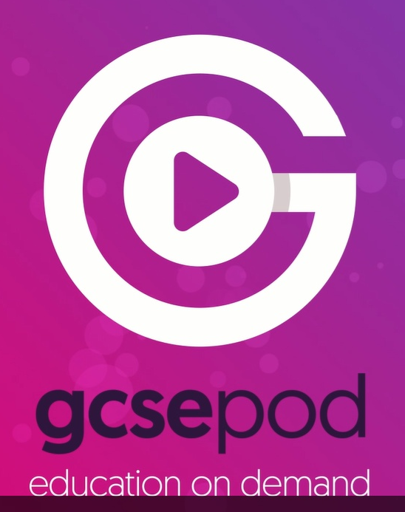
GCSEPod is here!
Click on picture for 1 minute video

Slide 3


What is GCSEPod?
In-depth subject knowledge
27 GCSE/IGCSE subjects
Covering every exam board
150 specifications
Over 6,000 audio-visual Pods
50,000+ Question Bank
Knowledge gap identification
Advanced reporting & monitoring
Correlation between usage and progress
One website, three apps

Slide 4
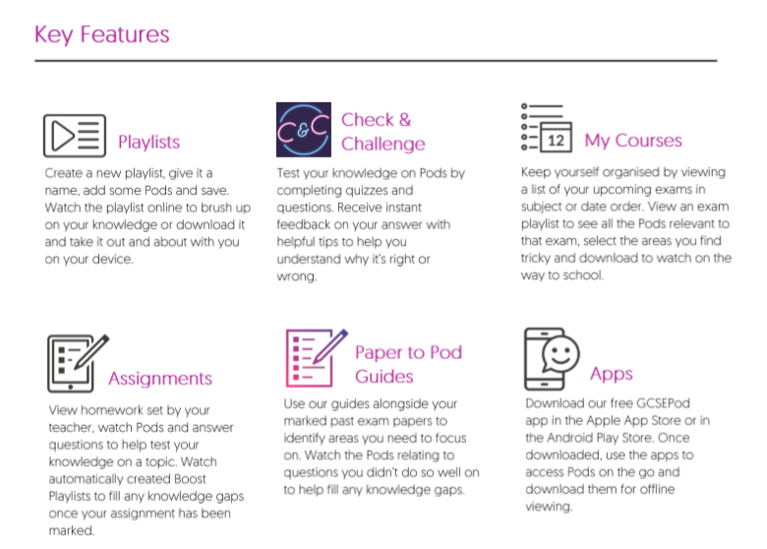

Slide 5
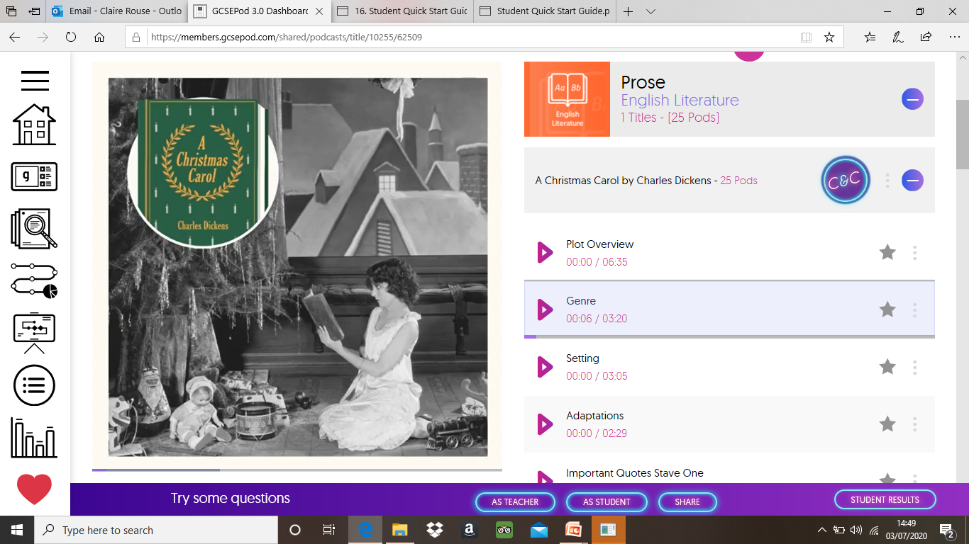
Subject knowledge in 3-5 minute chunks
At the heart of GCSEPod are our videos, we call them Pods.
Each one is a highly concentrated 3-5 minute burst of audio-visual learning.
Written by expert subject teachers
Quality assured
Narrated by professional voice over artists
Visuals produced by an award-winning design team
Each Pod is mapped to GCSE and IGCSE exam boards
Always keeping up to date with curriculum changes
Keywords, dates, quotes and diagrams

Slide 6


Download content so you can watch GCSEPod online or offline.

Slide 7

Everywhere, at anytime
At school
To the shops
On holiday
In the car
At home
On the paper round
At the gym
Travelling to and from school

Slide 8






Student Benefits
Easy to learn 3-5 minute short, sharp bursts of audio-visual learning
Access to content from 27 subjects, all mapped to your exam boards
Available online or offline
Ability to favourite any Pods on topics you find hard and revisit them
Ability to complete tests and receive instant feedback on assignments
You will accelerate your progress by receiving instant feedback on your knowledge gaps
Pre-made exam playlists, helping to organise your revision
Takes the stress out of learning
Links to your current curriculum plans

Slide 9
How do students watch GCSEPod?
Data from 2018/19 academic year
12,052,627 Pods watched in 18/19 academic year!
The highest hour of usage was 19.00hours
on May 14th where we saw 19,295 streams watched
(This was the day of the AQA English Literature Exam)
184,492 lonely streams took place between midnight and 4am

Slide 10
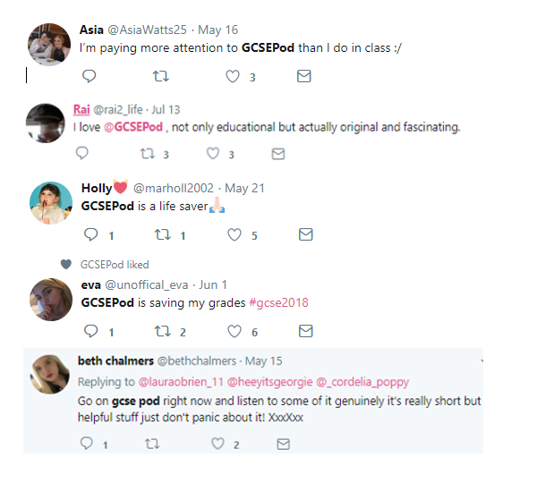

What are students saying about it?
GCSEPod has allowed me to multitask while learning, in addition to the method of presentation itself which actually brought information on a silver platter. GCSEPod is,
by far, flawless.
Student

Slide 11
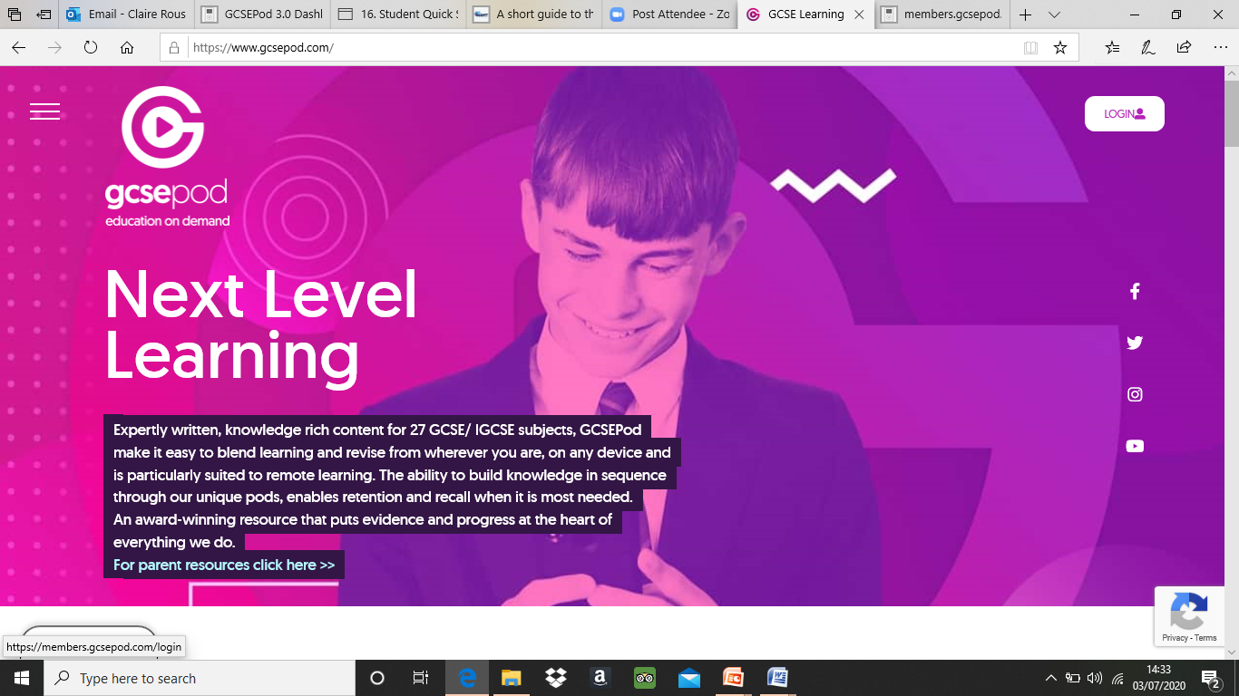
How to access your GCSE Pod Account…
Load up the website
www.gcsepod.com this can be done on a phone or pc
Go to the login button at the top right hand corner of the website...

Slide 12
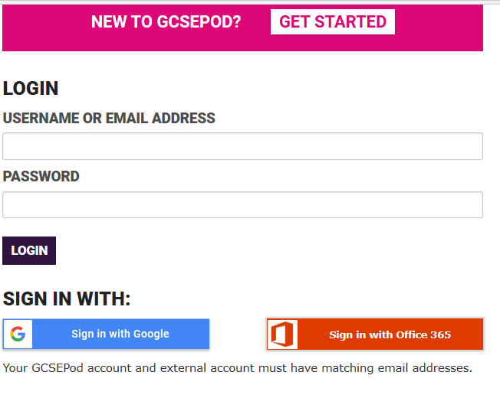
How to access your GCSE Pod Account…
You will be taken to this slide.
Log in with your Office 365 account. The username and password will be your school email address (yourusername@tda.education) and your school password!
Do not click ‘NEW TO GCSE POD’, or try to enter your school details into the username without clicking this button- it will not work.

Slide 13
If you get stuck with logging on...
Please email staff at the following:
servicedesk@tdet.education

Slide 14
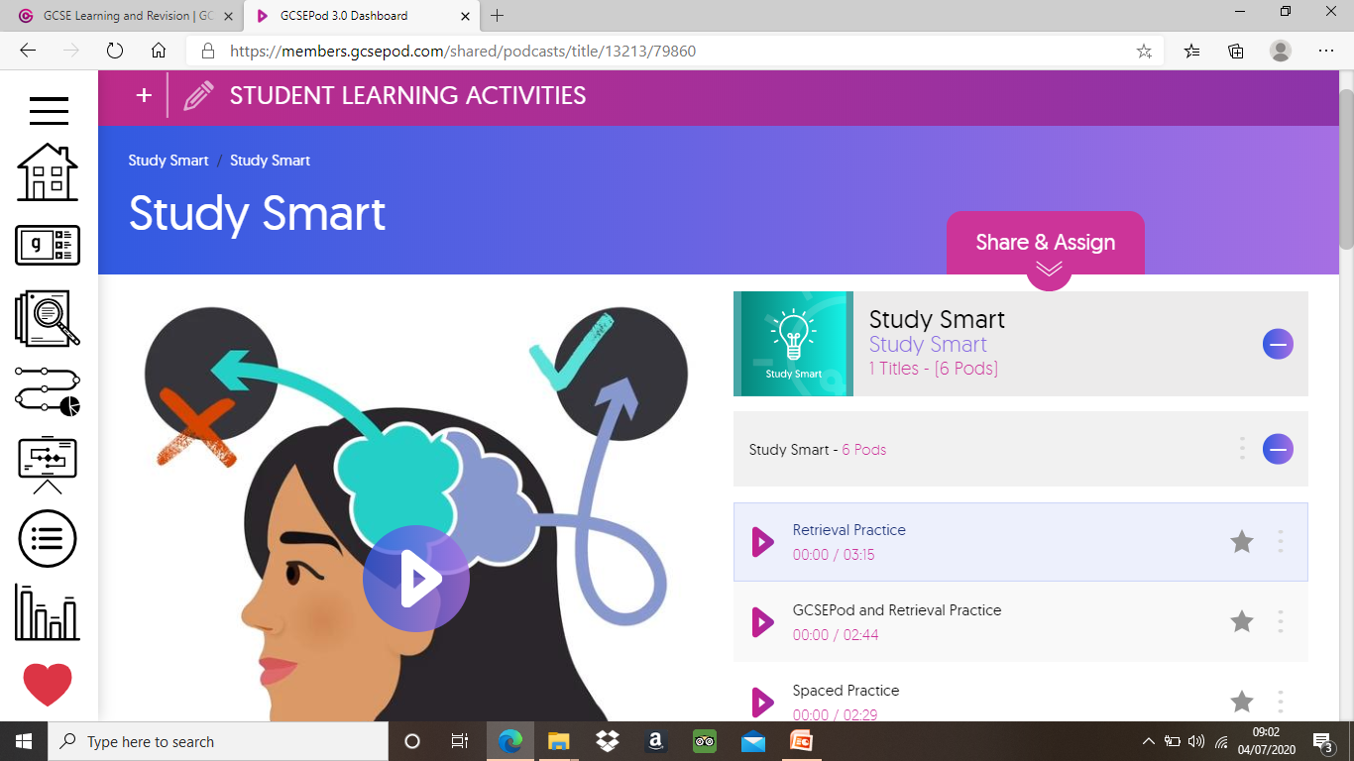
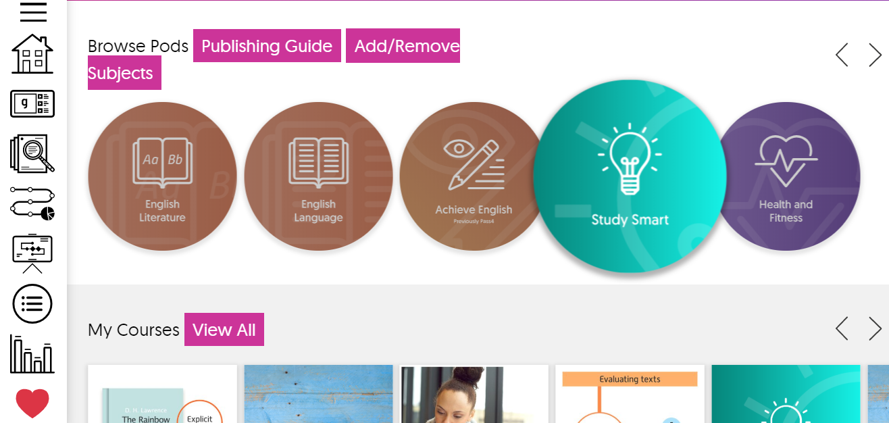
Getting started!
We now need you to go home and log into GCSE Pod and try a podcast out. The one we would like you to try can be found in the ‘Study Smart’ section. You will need to complete all pods within this section – they are 19 minutes in total!
We will be taking a register of those that have logged in to watch these, so please make sure you do!
If you can’t find it on the website- type it into the search bar at the top of the page!

